Slide 1
Radio Frequency Basics
Week 1

Slide 2
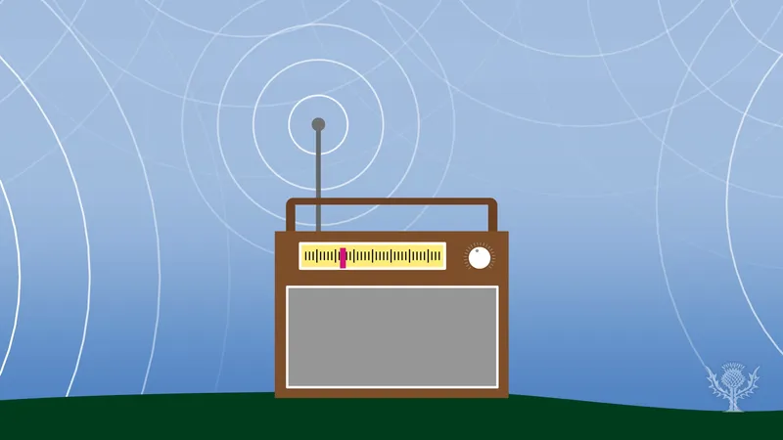
Radio Frequency
Radio Frequency (RF) is a form of non-ionizing radiation. It falls on the lowest end of the electromagnetic spectrum, which includes various types of radiation such as visible light, infrared, and microwaves.
RF technology enables wireless communication, allowing devices to exchange information without physical connections.
Despite being invisible to the human eye, RF waves play a crucial role in modern technology.

Slide 3
Definitions:
Oscillation: the completion of a full cycle, where the wave travels from its highest point (peak) to its lowest point (trough) and back to the peak again.
Frequency: the number of oscillations or cycles a radio wave completes in one second, measured in hertz (Hz).
Amplitude: the measure of the height or strength of the wave, representing the distance from the baseline (zero point) to the peak of the wave.

Slide 4
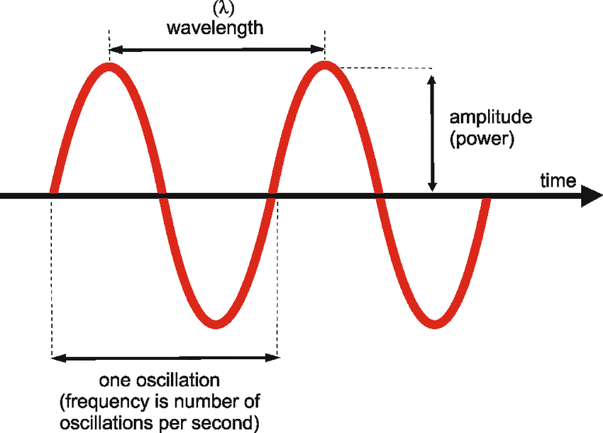
Oscillation, Frequency, and Amplitude (Visualized)

Slide 5
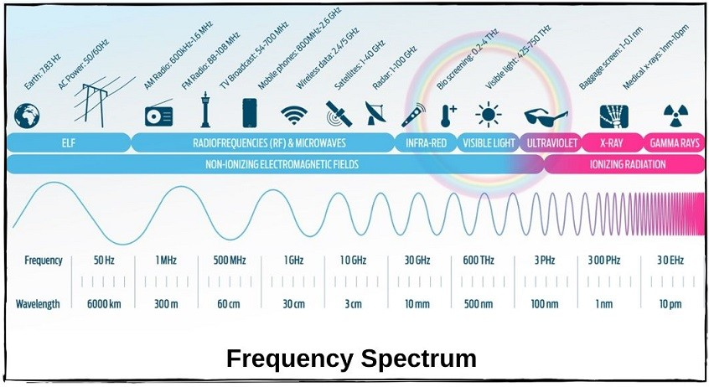
What Uses Radio Frequencies?
Many household and everyday items use Radio Frequency. Some of the most common ones are:
Phones & WiFi
Microwaves
TV’s & Remote Controls
Bluetooth Appliances
Digital Thermometers
Heart Monitors
AM / FM Radio

Slide 6
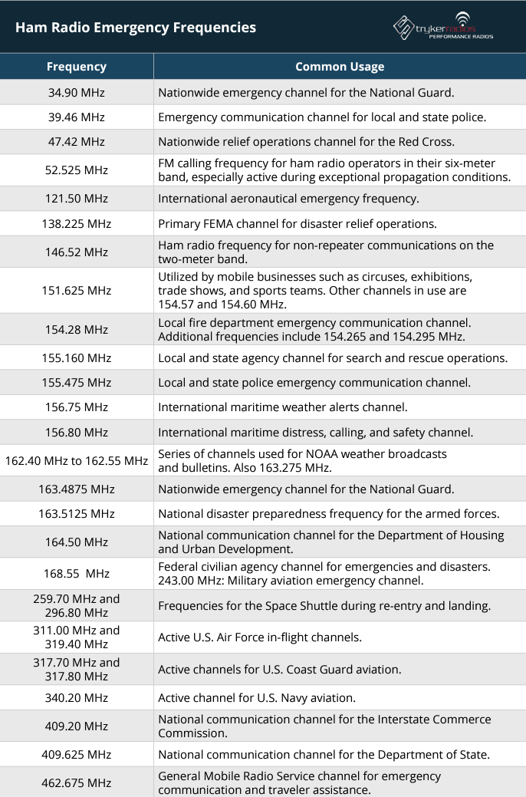
Emergency Radio
There are delegated radio frequencies for emergency purposes. Here are some common frequencies.
Keep in mind the measurements used for the frequencies listed.

Slide 7
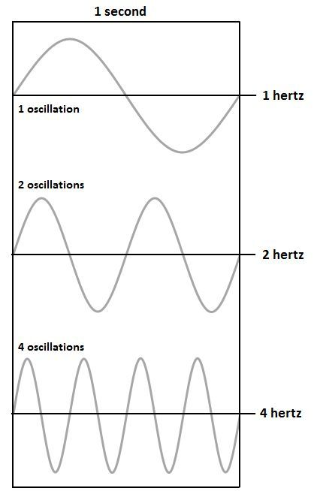
How are Radio Frequencies Transmitted?
RF waves are generated using electronic devices called transmitters.
Transmitters contain oscillating circuits that produce RF signals when supplied with electrical power.
These signals are then radiated into the surrounding space as electromagnetic waves.
1 Oscillation = 1 Hz.
1MHz = 1,000,000 Hz / 1 Million Oscillations per second
1GHz = 1,000,000,000 Hz / 1 Billion Oscillations per second

Slide 8
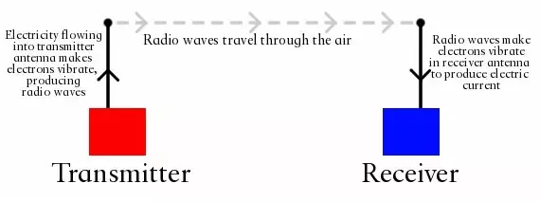
How are Radio Frequencies Received?
RF waves are received and detected by devices equipped with antennas and receivers.
Once the antenna captures the electromagnetic waves, it induces an alternating current (AC) in the antenna's conductive elements, corresponding to the frequency of the received signal.
The receiver processes these electrical signals with a tuner, extracting the transmitted information for various applications.

Slide 9
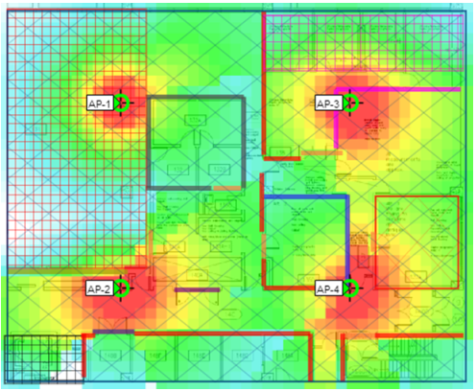
Heat Mapping
Heat mapping refers to the process of visualizing and analyzing the distribution and strength of Radio Frequency signals within a given area. This provides valuable insights into signal coverage, strength, and potential interference, aiding in the design, optimization, and troubleshooting of wireless communication systems.
By measuring signal strength at various points within the coverage area, engineers can create heat maps that visualize signal propagation and identify areas with poor coverage or dead zones.

Slide 10
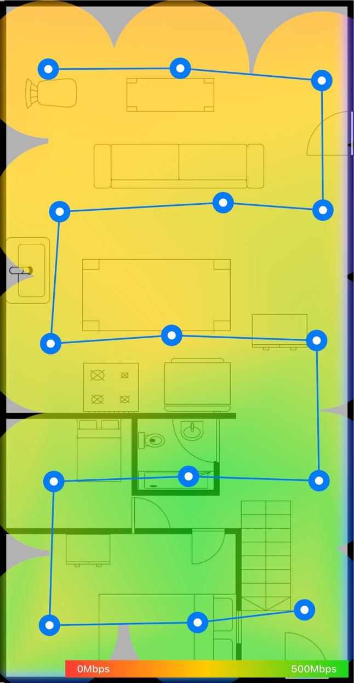
Lab 1-1 Heatmap Site Survey
Build out a floor plan (draw.io is a great source!)
Install NetSpot (or a similar app) on a smartphone.
Start a new project, and import your created floor plan.
Make sure to take accurate measurements to calibrate your floor plan.
Using the scan tool, walk from sector to sector and take scans. Walk to every sector and scan it until the map is complete.

Slide 11
Discussion Post - RF Device in The Wild
For this discussion post, look around your room/dorm/house/campus building for a device that uses RF in any capacity.
Identify the device, look into what form of RF it uses, and discuss what it uses it for.
Please write a paragraph about what the device is and its use cases, write a second paragraph about what type of RF it is using in as much detail as possible.
Lastly, please upload a photo of the RF device in the wild as part of your submission.

